Slide 1


Slide 2

4
ELASTICITY

Slide 3
After studying this chapter you will be able to
Define, calculate, and explain the factors that influence the price elasticity of demand
Define, calculate, and explain the factors that influence the cross elasticity of demand and the income elasticity of demand
Define, calculate, and explain the factors that influence the elasticity of supply
Copyright © 2013 Pearson Canada Inc., Toronto, Ontario

Slide 4
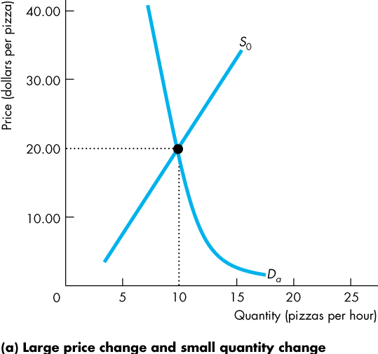
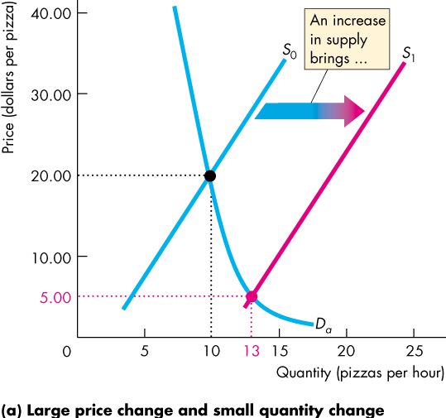
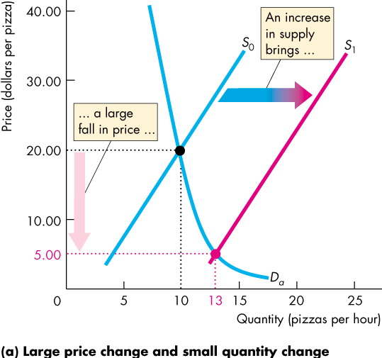
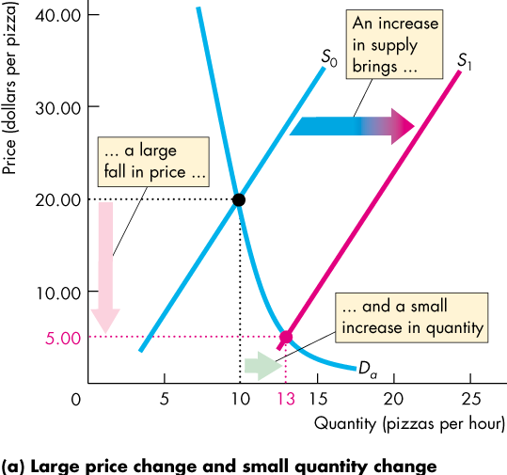
Price Elasticity of Demand
  In Figure 4.1(a), an increase in supply brings
  A large fall in price
  A small increase in the quantity demanded
Copyright © 2013 Pearson Canada Inc., Toronto, Ontario

Slide 5
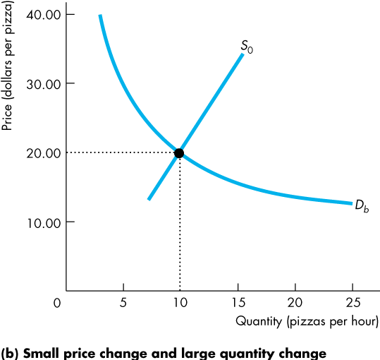
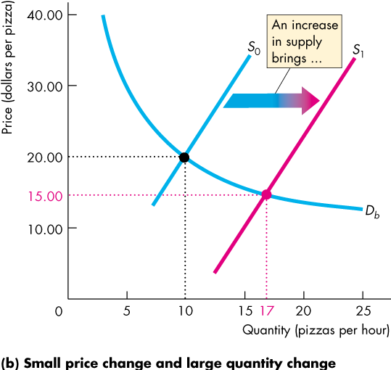
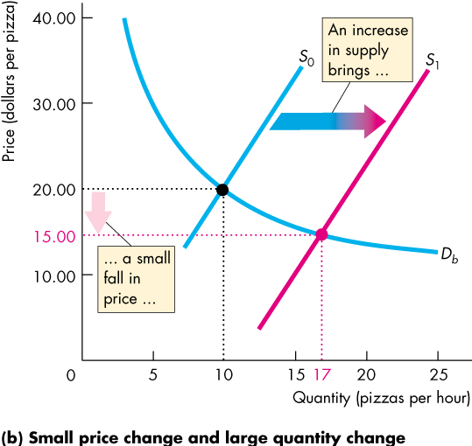
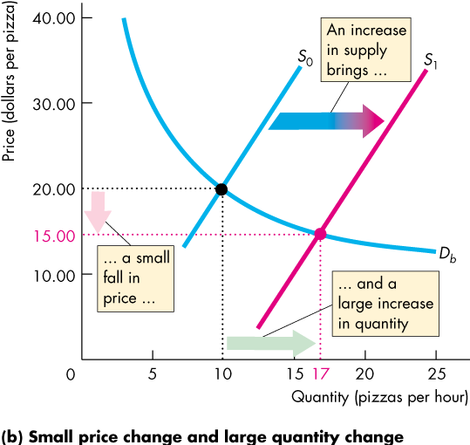
Price Elasticity of Demand
  In Figure 4.1(b), an increase in supply brings
  A small fall in price
  A large increase in the quantity demanded
Copyright © 2013 Pearson Canada Inc., Toronto, Ontario

Slide 6
Price Elasticity of Demand
  The contrast between the two outcomes in Figure 4.1 highlights the need for
  A measure of the responsiveness of the quantity demanded to a price change.
  The price elasticity of demand is a units-free measure of the responsiveness of the quantity demanded of a good to a change in its price when all other influences on buying plans remain the same.
Copyright © 2013 Pearson Canada Inc., Toronto, Ontario

Slide 7
Price Elasticity of Demand
Calculating Price Elasticity of Demand
  The price elasticity of demand is calculated by using the formula:
  Percentage change in quantity demanded
  Percentage change in price
Copyright © 2013 Pearson Canada Inc., Toronto, Ontario

Slide 8
Price Elasticity of Demand
  To calculate the price elasticity of demand:
  We express the change in price as a percentage of the average price—the average of the initial and new price,
  and we express the change in the quantity demanded as a percentage of the average quantity demanded—the average of the initial and new quantity.
Copyright © 2013 Pearson Canada Inc., Toronto, Ontario

Slide 9
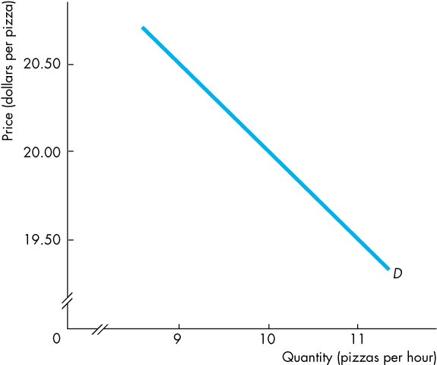
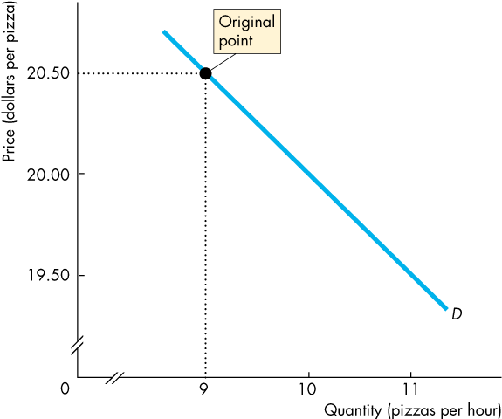
Price Elasticity of Demand
  Figure 4.2 calculates the price elasticity of demand for pizza.
  The price initially is $20.50 and the quantity demanded is 9 pizzas an hour.
Copyright © 2013 Pearson Canada Inc., Toronto, Ontario

Slide 10
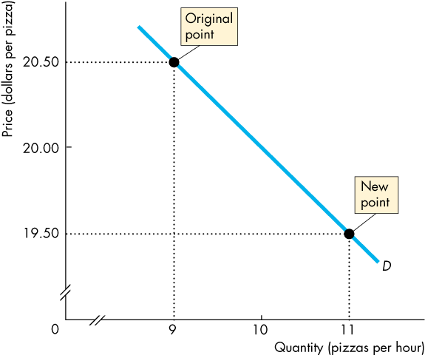
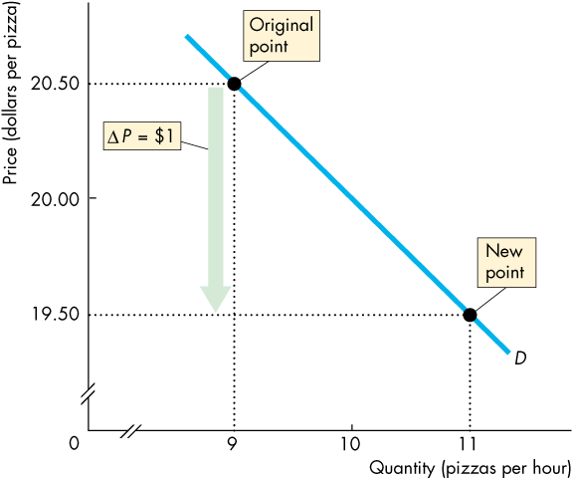
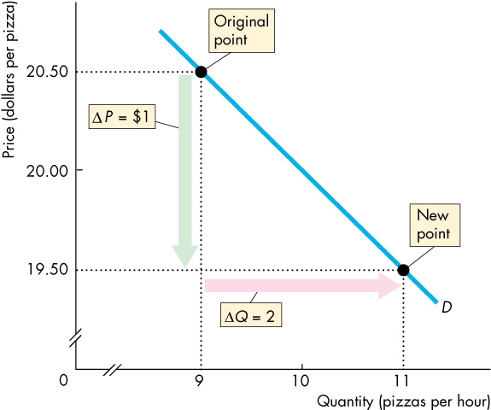
Price Elasticity of Demand
  The price falls to $19.50 and the quantity demanded increases to 11 pizzas an hour.
  The price falls by $1 and the quantity demanded increases by 2 pizzas an hour.
Copyright © 2013 Pearson Canada Inc., Toronto, Ontario

Slide 11
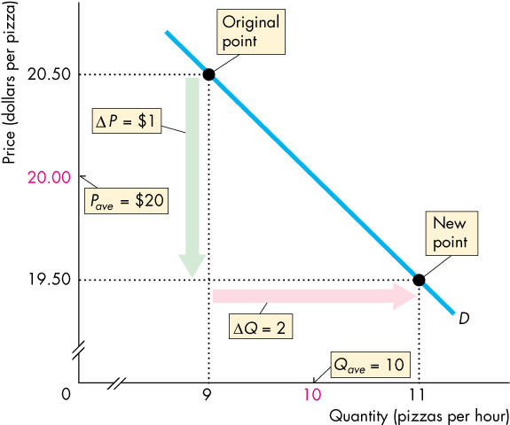
Price Elasticity of Demand
  The average price is $20 and the average quantity demanded is 10 pizzas an hour.
Copyright © 2013 Pearson Canada Inc., Toronto, Ontario

Slide 12
Price Elasticity of Demand
  The percentage change in quantity demanded, %ΔQ, is calculated as
  ΔQ/Q_{ave} x 100, which is
  (2/10) x 100 = 20%.
  The percentage change in price, %ΔP, is calculated as ΔP/P_{ave} x 100, which is
  ($1/$20) x 100 = 5%.
Copyright © 2013 Pearson Canada Inc., Toronto, Ontario

Slide 13
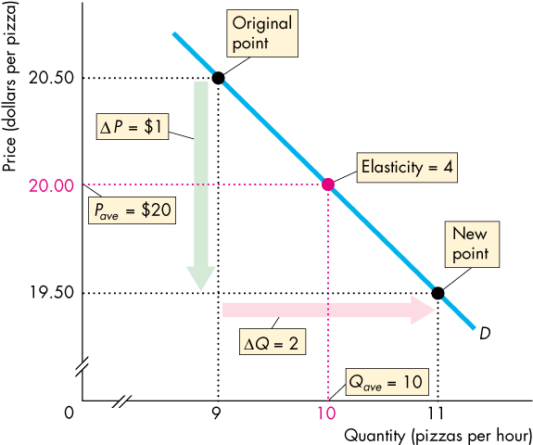
Price Elasticity of Demand
  The price elasticity of demand is
  %ΔQ / %ΔP = 20% / 5%
  = 4.
Copyright © 2013 Pearson Canada Inc., Toronto, Ontario

Slide 14
Price Elasticity of Demand
  Average Price and Quantity
  By using the average price and average quantity, we get the same elasticity value regardless of whether the price rises or falls.
  Percentages and Proportions
  The ratio of two proportionate changes is the same as the ratio of two percentage changes.
  %ΔQ / %ΔP = ΔQ / ΔP
Copyright © 2013 Pearson Canada Inc., Toronto, Ontario

Slide 15
Price Elasticity of Demand
  A Units-Free Measure
  Elasticity is a ratio of percentages, so a change in the units of measurement of price or quantity leaves the elasticity value the same.
  Minus Sign and Elasticity
  The formula yields a negative value, because price and quantity move in opposite directions.
  But it is the magnitude, or absolute value, that reveals how responsive the quantity change has been to a price change.
Copyright © 2013 Pearson Canada Inc., Toronto, Ontario

Slide 16
Price Elasticity of Demand
Inelastic and Elastic Demand
  Demand can be inelastic, unit elastic, or elastic, and can range from zero to infinity.
  If the quantity demanded doesn’t change when the price changes, the price elasticity of demand is zero and the good has a perfectly inelastic demand.
Copyright © 2013 Pearson Canada Inc., Toronto, Ontario

Slide 17
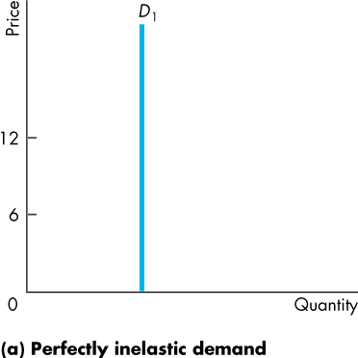
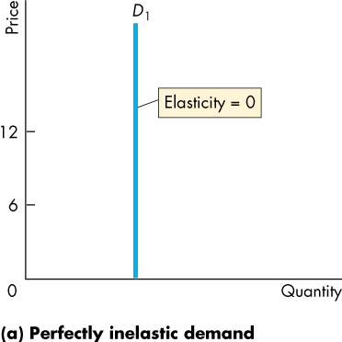
Price Elasticity of Demand
  Figure 4.3(a) illustrates the case of a good that has a perfectly inelastic demand.
  The demand curve is vertical.
Copyright © 2013 Pearson Canada Inc., Toronto, Ontario

Slide 18
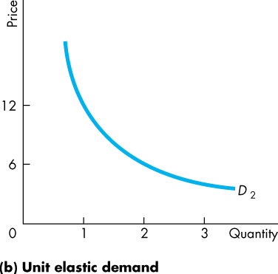
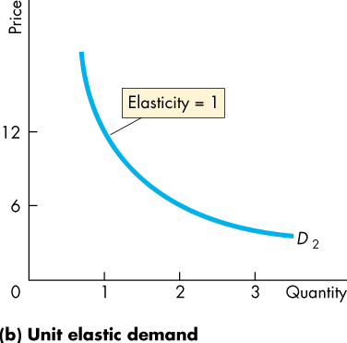
Price Elasticity of Demand
  If the percentage change in the quantity demanded equals the percentage change in price, …
  the price elasticity of demand equals 1 and the good has unit elastic demand.
  Figure 4.3(b) illustrates this case—a demand curve with ever declining slope.
Copyright © 2013 Pearson Canada Inc., Toronto, Ontario

Slide 19
Price Elasticity of Demand
  If the percentage change in the quantity demanded is smaller than the percentage change in price,
  the price elasticity of demand is less than 1 and the good has inelastic demand.
  If the percentage change in the quantity demanded is greater than the percentage change in price,
  the price elasticity of demand is greater than 1 and the good has elastic demand.
Copyright © 2013 Pearson Canada Inc., Toronto, Ontario

Slide 20
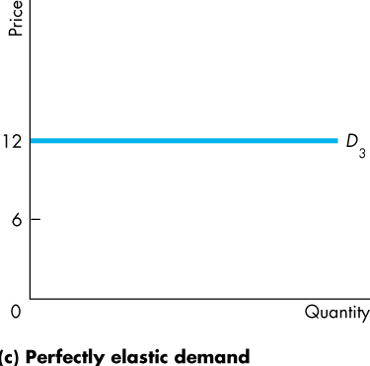
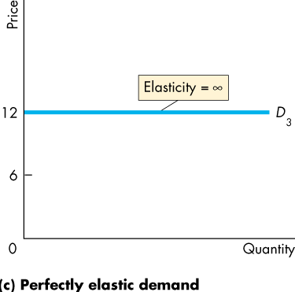
Price Elasticity of Demand
  If the percentage change in the quantity demanded is infinitely large when the price barely changes, …
  the price elasticity of demand is infinite and the good has a perfectly elastic demand.
  Figure 4.3(c) illustrates the case of perfectly elastic demand—a horizontal demand curve.
Copyright © 2013 Pearson Canada Inc., Toronto, Ontario

Slide 21
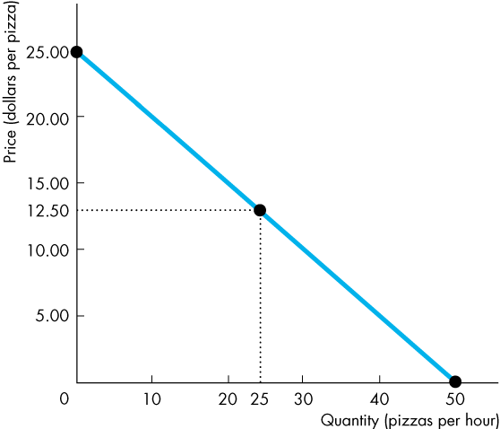
Price Elasticity of Demand
Elasticity Along a Linear Demand Curve
  Figure 4.4 shows how the elasticity of demand changes along a linear demand curve.
  At the mid-point of the demand curve, demand is unit elastic.
Copyright © 2013 Pearson Canada Inc., Toronto, Ontario

Slide 22
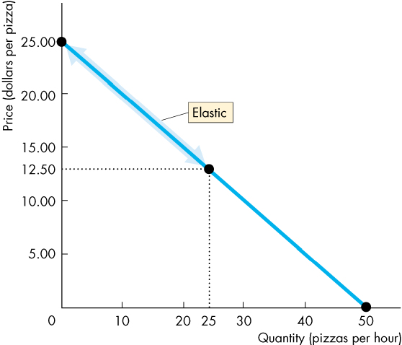
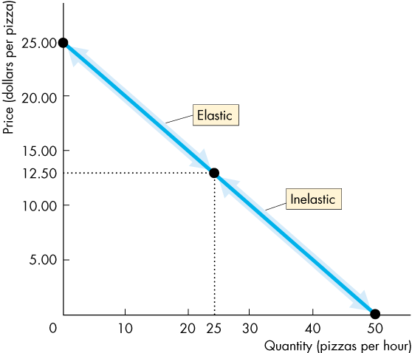
Price Elasticity of Demand
  At prices above the mid-point of the demand curve, demand is elastic.
  At prices below the mid-point of the demand curve, demand is inelastic.
Copyright © 2013 Pearson Canada Inc., Toronto, Ontario

Slide 23
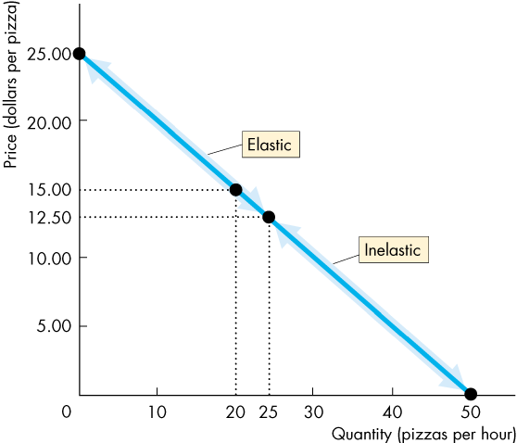
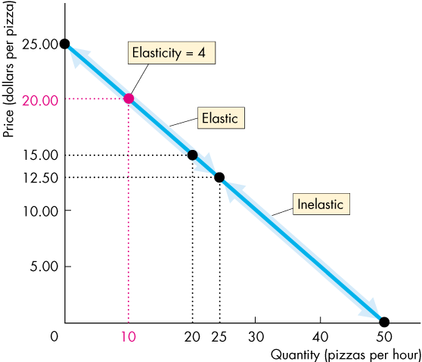
Price Elasticity of Demand
  For example, if the price falls from $25 to $15, the quantity demanded increases from 0 to 20 pizzas an hour.
  The average price is $20 and the average quantity
  is 10 pizzas.
  The price elasticity of demand is (20/10)/(10/20), which equals 4.
Copyright © 2013 Pearson Canada Inc., Toronto, Ontario

Slide 24
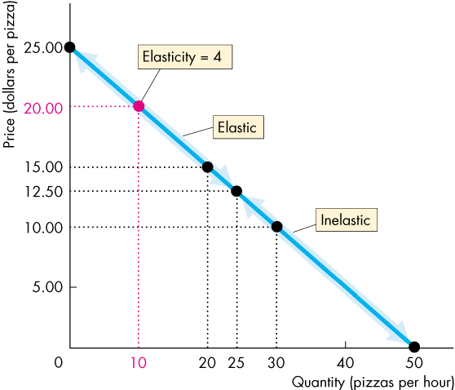
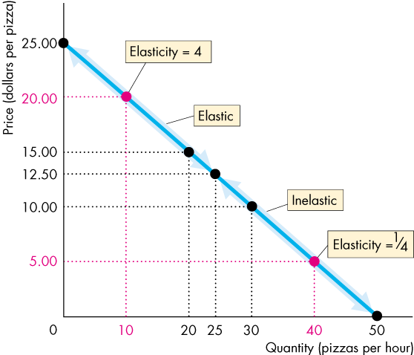
Price Elasticity of Demand
  If the price falls from
  $10 to $0, the quantity demanded increases from 30 to 50 pizzas an hour.
  The average price is $5 and the average quantity is 40 pizzas.
  The price elasticity is (20/40)/(10/5), which equals 1/4.
Copyright © 2013 Pearson Canada Inc., Toronto, Ontario

Slide 25
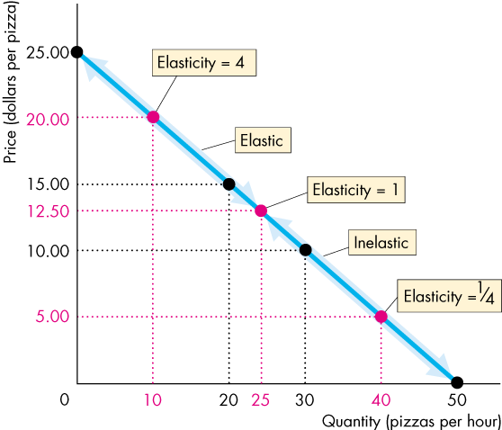
Price Elasticity of Demand
  If the price falls from
  $15 to $10, the quantity demanded increases from 20 to 30 pizzas an hour.
  The average price is $12.50 and the average quantity is 25 pizzas.
  The price elasticity is (10/25)/(5/12.5), which equals 1.
Copyright © 2013 Pearson Canada Inc., Toronto, Ontario

Slide 26
Price Elasticity of Demand
Total Revenue and Elasticity
  The total revenue from the sale of good or service equals the price of the good multiplied by the quantity sold.
  When the price changes, total revenue also changes.
  But a rise in price doesn’t always increase total revenue.
Copyright © 2013 Pearson Canada Inc., Toronto, Ontario

Slide 27
Price Elasticity of Demand
  The change in total revenue due to a change in price depends on the elasticity of demand:
  If demand is elastic, a 1 percent price cut increases the quantity sold by more than 1 percent, and total revenue increases.
  If demand is inelastic, a 1 percent price cut increases the quantity sold by less than 1 percent, and total revenues decreases.
  If demand is unit elastic, a 1 percent price cut increases the quantity sold by 1 percent, and total revenue remains unchanged.
Copyright © 2013 Pearson Canada Inc., Toronto, Ontario

Slide 28
Price Elasticity of Demand
  The total revenue test is a method of estimating the price elasticity of demand by observing the change in total revenue that results from a price change (when all other influences on the quantity sold remain the same).
  If a price cut increases total revenue, demand is
  elastic.
  If a price cut decreases total revenue, demand is inelastic.
  If a price cut leaves total revenue unchanged, demand is unit elastic.
Copyright © 2013 Pearson Canada Inc., Toronto, Ontario

Slide 29
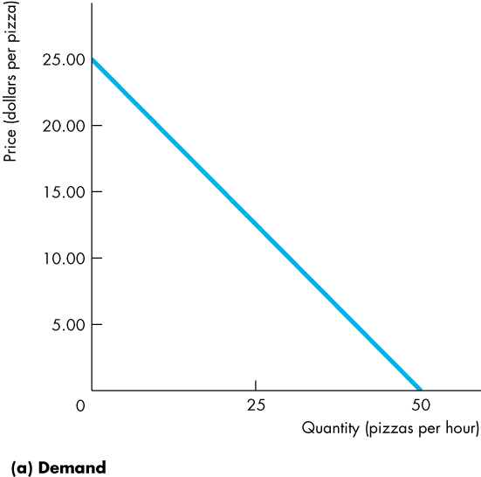
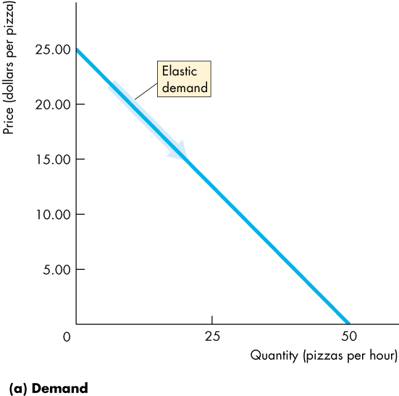
Price Elasticity of Demand
  Figure 4.5 shows the relationship between elasticity of demand and the total revenue.
  As the price falls from $25 to $12.50, the quantity demanded increases from 0 to 25 pizzas.
  Demand is elastic, and total revenue increases.
Copyright © 2013 Pearson Canada Inc., Toronto, Ontario

Slide 30
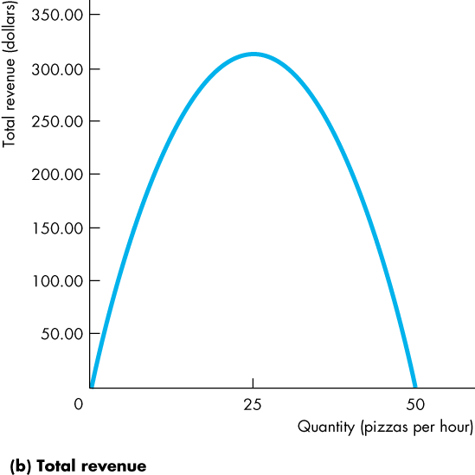
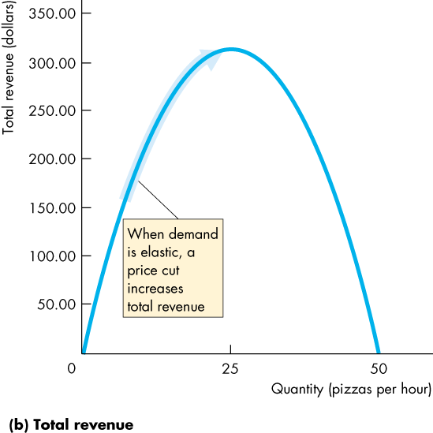
Price Elasticity of Demand
  In part (b), as the quantity increases from 0 to 25 pizzas, demand is elastic, and total revenue increases.
Copyright © 2013 Pearson Canada Inc., Toronto, Ontario

Slide 31
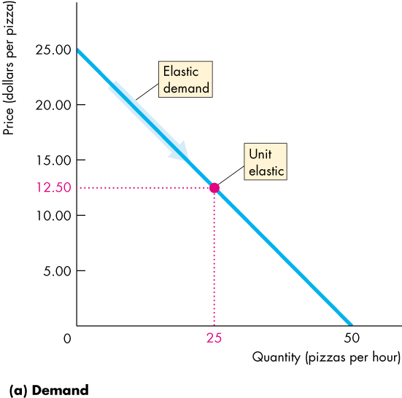
Price Elasticity of Demand
  At $12.50, demand is unit elastic and total revenue stops increasing.
Copyright © 2013 Pearson Canada Inc., Toronto, Ontario

Slide 32
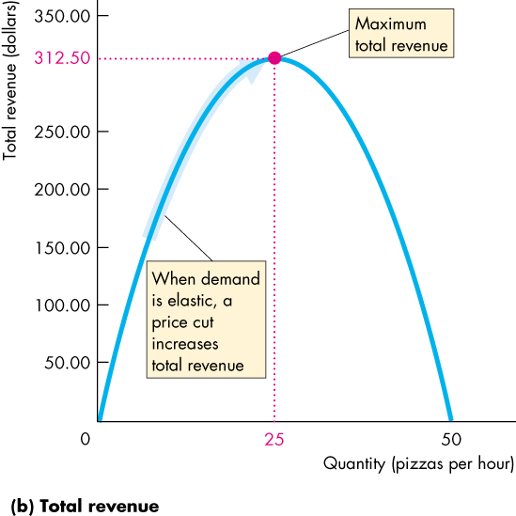
Price Elasticity of Demand
  At 25, demand is unit elastic, and total revenue is at its maximum.
Copyright © 2013 Pearson Canada Inc., Toronto, Ontario

Slide 33
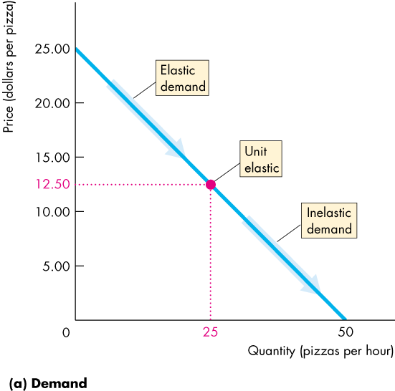
Price Elasticity of Demand
  As the price falls from $12.50 to zero, the quantity demanded increases from 25 to 50 pizzas.
  Demand is inelastic, and total revenue decreases.
Copyright © 2013 Pearson Canada Inc., Toronto, Ontario

Slide 34
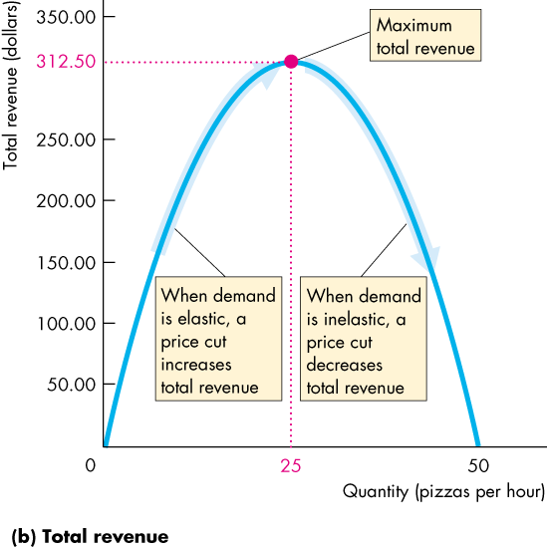
Price Elasticity of Demand
  As the quantity increases from 25 to 50 pizzas, demand is inelastic, and total revenue decreases.
Copyright © 2013 Pearson Canada Inc., Toronto, Ontario

Slide 35
Price Elasticity of Demand
Your Expenditure and Your Elasticity
  If your demand is elastic, a 1 percent price cut increases the quantity you buy by more than 1 percent and your expenditure on the item increases.
  If your demand is inelastic, a 1 percent price cut increases the quantity you buy by less than 1 percent and your expenditure on the item decreases.
  If your demand is unit elastic, a 1 percent price cut increases the quantity you buy by 1 percent and your expenditure on the item does not change.
Copyright © 2013 Pearson Canada Inc., Toronto, Ontario

Slide 36
Price Elasticity of Demand
The Factors That Influence the Elasticity of Demand
  The elasticity of demand for a good depends on:
  The closeness of substitutes
  The proportion of income spent on the good
  The time elapsed since a price change
Copyright © 2013 Pearson Canada Inc., Toronto, Ontario

Slide 37
Price Elasticity of Demand
  Closeness of Substitutes
  The closer the substitutes for a good or service, the more elastic are the demand for the good or service.
  Necessities, such as food or housing, generally have inelastic demand.
  Luxuries, such as exotic vacations, generally have elastic demand.
Copyright © 2013 Pearson Canada Inc., Toronto, Ontario

Slide 38
Price Elasticity of Demand
  Proportion of Income Spent on the Good
  The greater the proportion of income consumers spend on a good, the larger is the elasticity of demand for that good.
  Time Elapsed Since Price Change
  The more time consumers have to adjust to a price change the more elastic is the demand for that good.
Copyright © 2013 Pearson Canada Inc., Toronto, Ontario

Slide 39
More Elasticities of Demand
Cross Elasticity of Demand
  The cross elasticity of demand is a measure of the responsiveness of demand for a good to a change in the price of a substitute or a complement, other things remaining the same.
  The formula for calculating the cross elasticity is:
  Percentage change in quantity demanded
  Percentage change in price of substitute or complement
Copyright © 2013 Pearson Canada Inc., Toronto, Ontario

Slide 40
More Elasticities of Demand
  The cross elasticity of demand for
  a substitute is positive.
  a complement is negative.
Copyright © 2013 Pearson Canada Inc., Toronto, Ontario

Slide 41
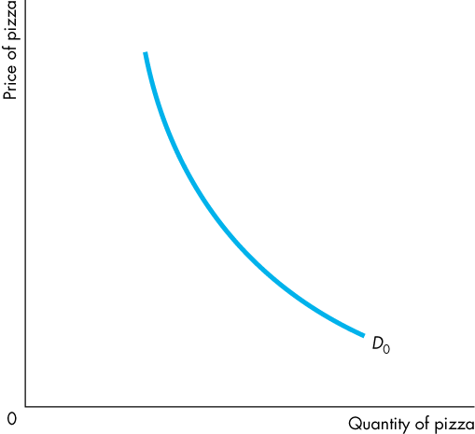
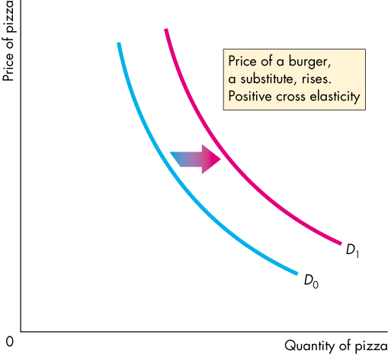
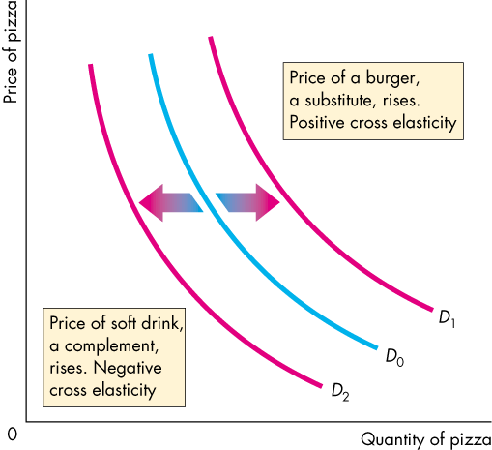
More Elasticities of Demand
  Figure 4.6 shows the increase in the demand for pizza when the price of a burger (a substitute for pizza) rises.
  The figure also shows the decrease in demand for pizza when the price of a soft drink (a complement of pizza) rises.
Copyright © 2013 Pearson Canada Inc., Toronto, Ontario

Slide 42
More Elasticities of Demand
Income Elasticity of Demand
  The income elasticity of demand measures how the quantity demanded of a good responds to a change in income, other things remaining the same.
  The formula for calculating the income elasticity of demand is
  Percentage change in quantity demanded
  Percentage change in income
Copyright © 2013 Pearson Canada Inc., Toronto, Ontario

Slide 43
More Elasticities of Demand
  If the income elasticity of demand is greater than 1, demand is income elastic and the good is a normal good.
  If the income elasticity of demand is greater than zero but less than 1, demand is income inelastic and the good is a normal good.
  If the income elasticity of demand is less than zero (negative) the good is an inferior good.
Copyright © 2013 Pearson Canada Inc., Toronto, Ontario

Slide 44
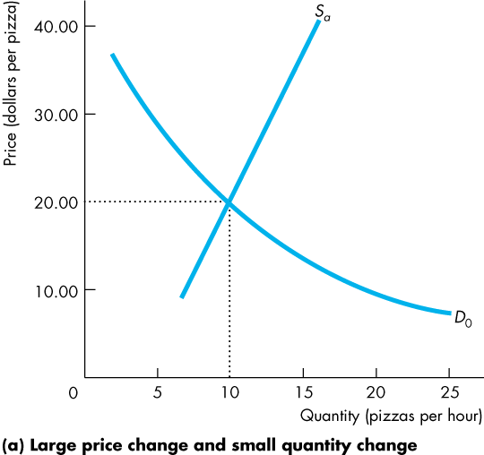
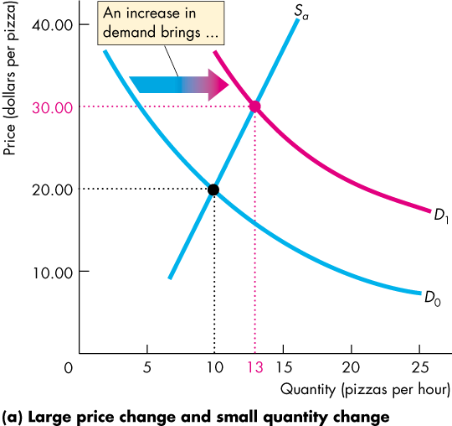
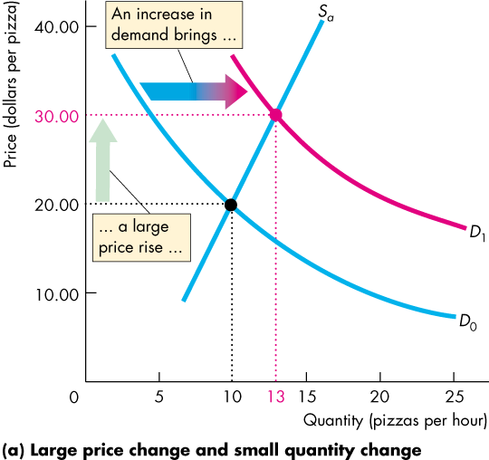
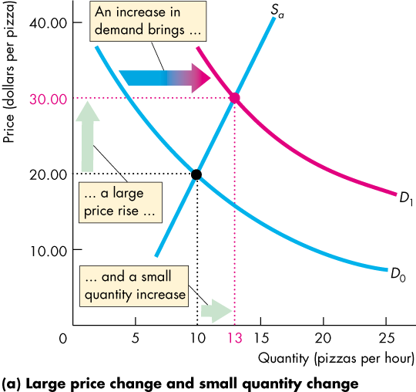
Elasticity of Supply
  When demand increases, is the change in the quantity supplied small or large?
  In Figure 4.7(a), an increase in demand brings
  A large rise in price
  A small increase in the quantity supplied
Copyright © 2013 Pearson Canada Inc., Toronto, Ontario

Slide 45
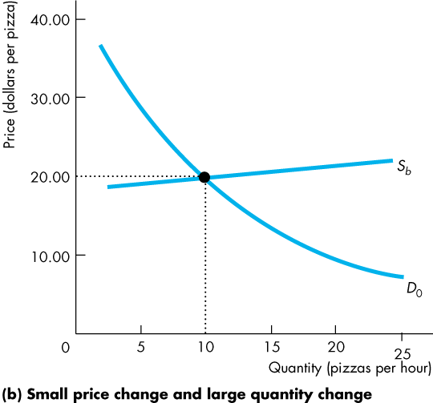
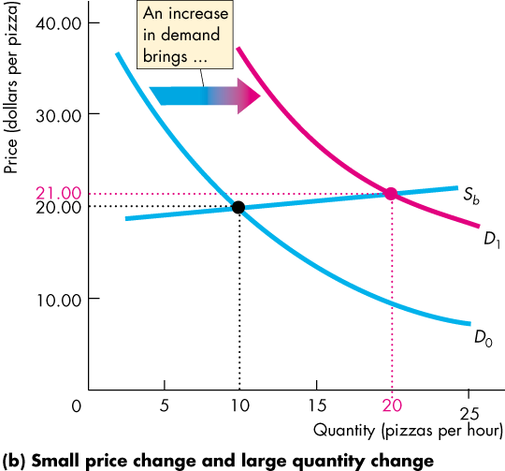
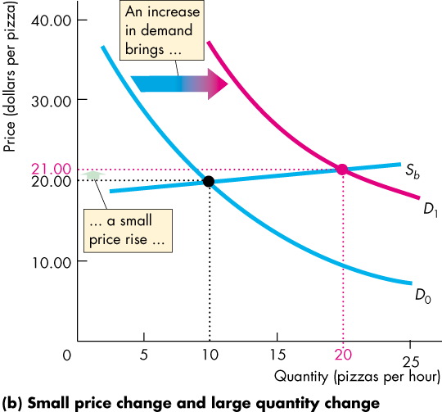
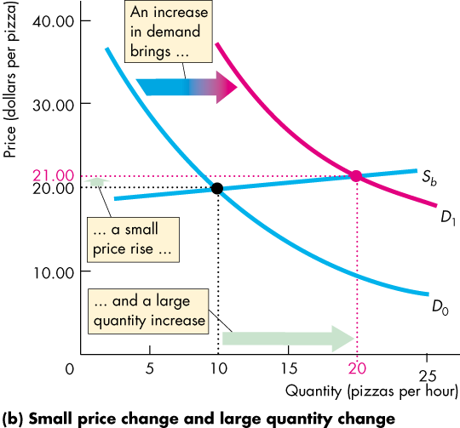
Elasticity of Supply
  In Figure 4.7(b), an increase in demand brings
  A small rise in price
  A large increase in the quantity supplied
Copyright © 2013 Pearson Canada Inc., Toronto, Ontario

Slide 46
Elasticity of Supply
  The contrast between the two outcomes in Figure 4.7 highlights the need for
  A measure of the responsiveness of the quantity supplied to a price change.
  The elasticity of supply measures the responsiveness of the quantity supplied to a change in the price of a good when all other influences on selling plans remain the same.
Copyright © 2013 Pearson Canada Inc., Toronto, Ontario

Slide 47
Elasticity of Supply
  Calculating the Elasticity of Supply
  The elasticity of supply is calculated by using the formula:
  Percentage change in quantity supplied
  Percentage change in price
Copyright © 2013 Pearson Canada Inc., Toronto, Ontario

Slide 48
Elasticity of Supply
  Figure 4.8 on the next slide shows three cases of the elasticity of supply.
  Supply is perfectly inelastic if the supply curve is vertical and the elasticity of supply is 0.
  Supply is unit elastic if the supply curve is linear and passes through the origin. (Note that slope is irrelevant.)
  Supply is perfectly elastic if the supply curve is horizontal and the elasticity of supply is infinite.
Copyright © 2013 Pearson Canada Inc., Toronto, Ontario

Slide 49
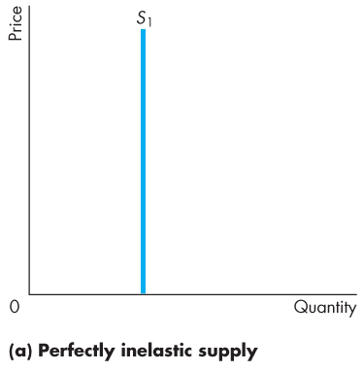
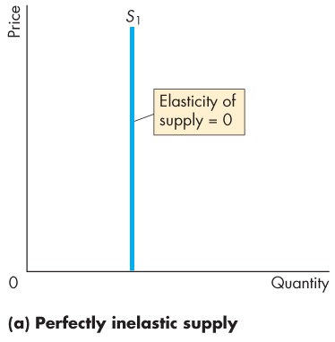




Elasticity of Supply
Copyright © 2013 Pearson Canada Inc., Toronto, Ontario

Slide 50
Elasticity of Supply
The Factors That Influence the Elasticity of Supply
  The elasticity of supply depends on
  Resource substitution possibilities
  Time frame for supply decision
  Resource Substitution Possibilities
  The easier it is to substitute among the resources used to produce a good or service, the greater is its elasticity of supply.
Copyright © 2013 Pearson Canada Inc., Toronto, Ontario

Slide 51
Elasticity of Supply
  Time Frame for Supply Decision
  The more time that passes after a price change, the greater is the elasticity of supply.
  Momentary supply is perfectly inelastic. The quantity supplied immediately following a price change is constant.
  Short-run supply is somewhat elastic.
  Long-run supply is the most elastic.
  Table 4.1 provides a glossary of the all elasticity measures.
Copyright © 2013 Pearson Canada Inc., Toronto, Ontario

